Slide 1
Lecture Review

Slide 2
Process Design of Heat Exchanger
Fouling reduces the effective heat transfer
KERN method:
#1 thermodynamical properties of hot and cold fluids (caloric temp / arithmetic mean temp)
#2 Energy balance, find the heat duty
#3 assume

Slide 3


Applied Thermal Engineering Development and validation of a condenser three zones model
INPUT:
Air supply temperature
Air mass flow rate
Refrigerant supply temperature (or Overheating)
Exhaust subcooling (->superheat for evap model)
Refrigerant mass flow rate
OUTPUT:
Pressures/temperatures in each zone
Corresponding heat flows
Geometrical repartition
Pressure drop on air side
One spec. heat transfer coeff. for each zone
Deterministic vs theoretical-experimental model
Deterministic
Heat exchanger geometry is known
Identify heat transfer / friction factor correlations
Theoretical-experimental
Unknown geometry
Performance is known
Assumptions:
Pure counterflow/crossflow/combination
Fluids homogenously distributed
Lubricant doesn´t affect heat transfer coeff

Slide 4
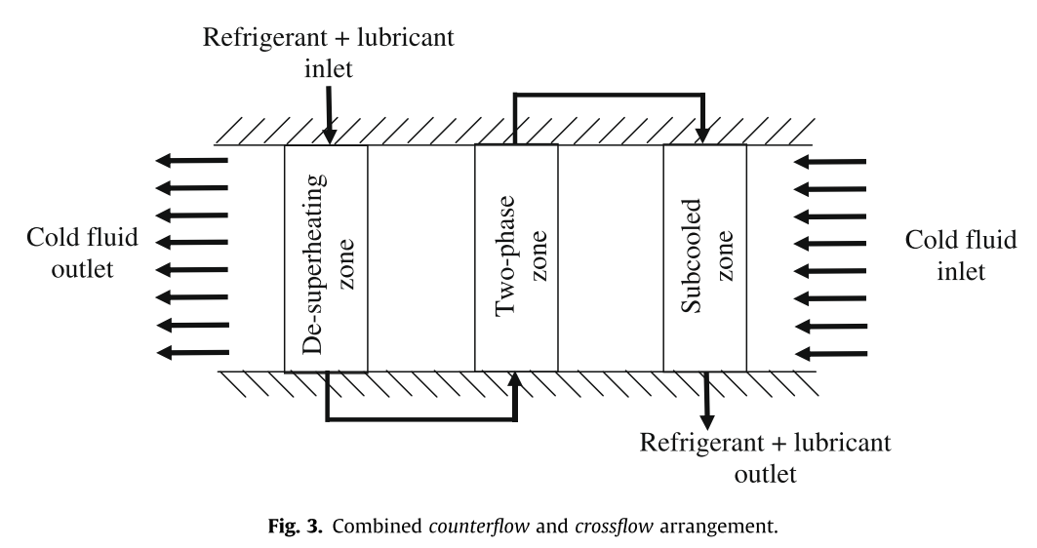
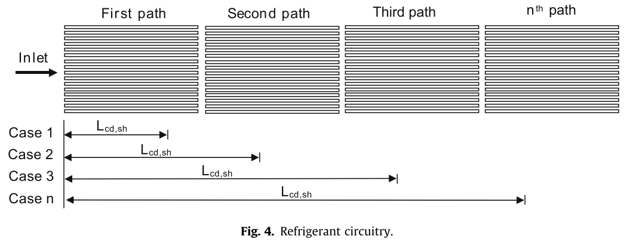
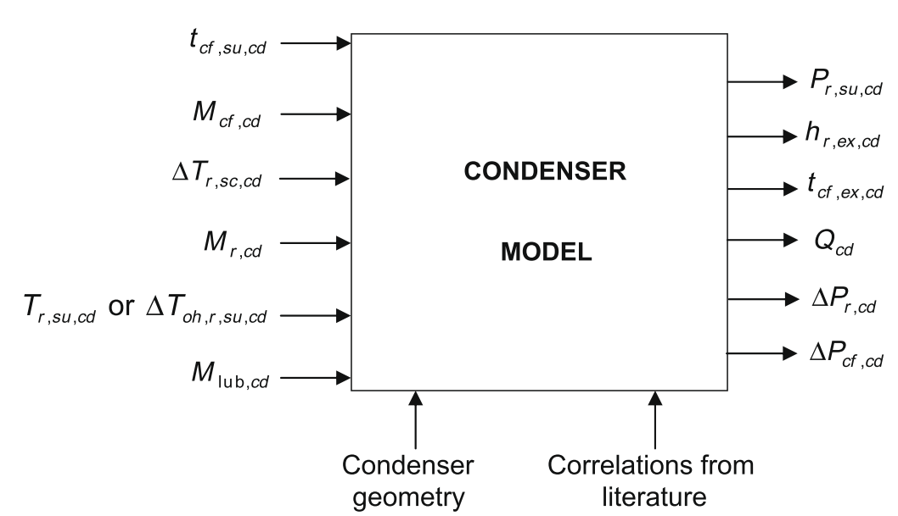
Model

Slide 5

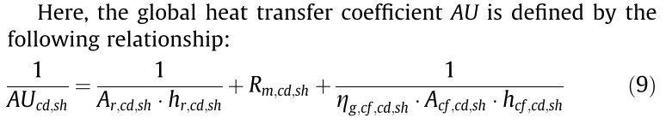
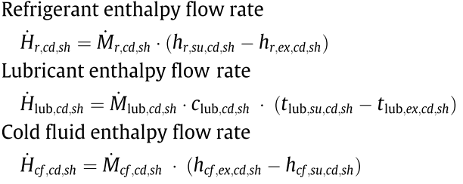
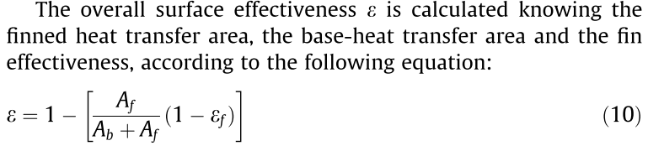
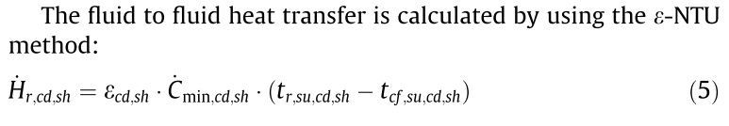
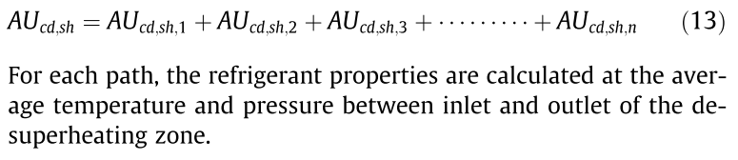
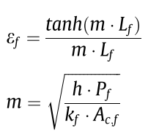

Equations
REFR
OIL
AIR

Slide 6
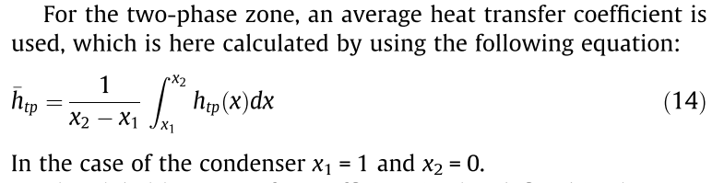


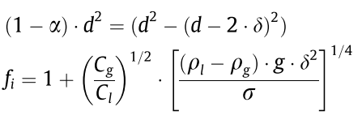
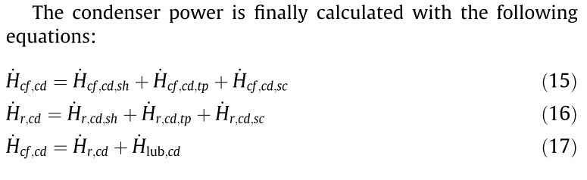
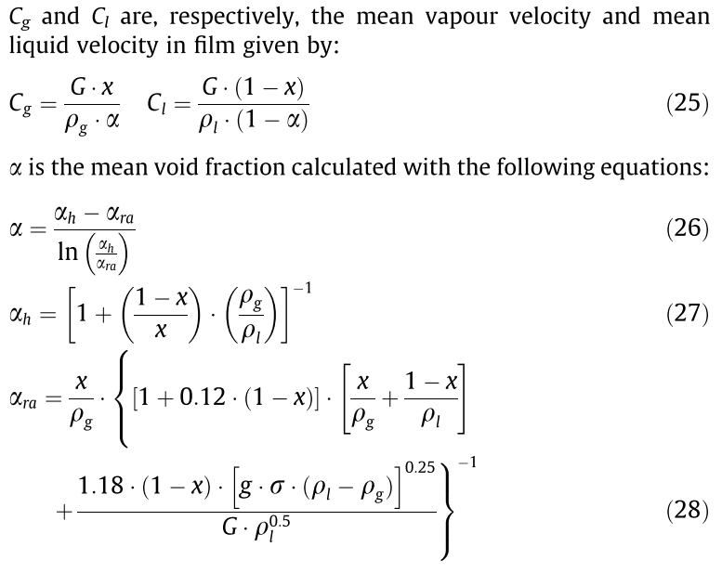

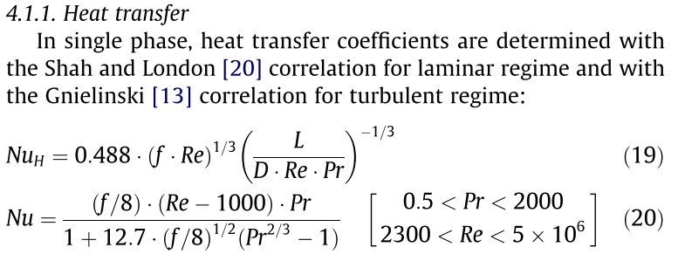
Equations

Slide 7
ACHP – Graphical User Interface
INPUT:
Working Fluid (R290)
Superheat (5K)
Charge (3x150g)
Fin geometry
Tube geometry
Compressor polynomials
OUTPUT:

Slide 8
Python Modeling

